Slide 1
Keep it Secret, Keep it Safe
A Security Love Story

Slide 2

SOFTWARE HUMANS LOVE TO USE

Slide 3

Obligatory LOTR Image

Slide 4
DISCLAIMER
Notes:
I am not a security expert. At best I’m a security enthusiast.
Validate any and all claims I make here.
Do your own research!

Slide 5
What’s in a secret?
Anything that gives you the creepy crawlies thinking about sending by email
Connection Strings
User credentials
API Access Keys
Keys to the Castle
Notes:
Secrets are what we use to get access from one system to another.
Lose control of a secret and you lose control of the data in the accessible service

Slide 6
Does your web.config look like this?
<configuration>
<connectionStrings>
<add name="CCDB" connectionString="Server=db1;Database=creditCards;User Id=bob; Password=abc123!!@;"/>
</connectionStrings>
<appsettings>
<add key="SlackToken" value="ksiji83dcjs0234027fdj02" />
<add key="AADToken" value="39d83j3js0aq2l39edhf8403" />
</appsettings>
</configuration>
Notes:
Oh no! Clear text tokens and password. What if an attacker takes a copy of this file?

Slide 7
Or app.settings like this?
{
"ccdb": {
"conn" : "Server=db1;Database=creditCards;User Id=bob; Password=abc123!!@; "
},
"slackToken" : "ksiji83dcjs0234027fdj02",
"aadToken" : "39d83j3js0aq2l39edhf8403"
}

Slide 8

Notes:
Let’s never do this again. There are proven options and it is our responsibility to use them.

Slide 9
Who cares? IT should secure the server!
Software breaches don’t care about your hardened server
ASP.NET Security Advisory 2416728
Bad download implementations
Commit secrets to source control
If someone breaches the server’s file system, don’t give them access to EVERYTHING else
Notes:
Yes IT should be securing the servers. But everything is breachable, we have to layer the security.
Server security is for naught if our software screws up and reveals its own secrets.
Script kiddie gains file system access and scans for typical juicy files like web.config’s? Don’t give them anything to play with!

Slide 10
Rules of Security
Someone is going to goof
It’s probably going to be you
Protect your system from you
Notes:
Security is hard.
It is extremely easy to miss something.
If we build our system pessimistically with the hopes that no single failure will breach the entire system, we are far better off.
If you don’t need it, don’t store it.
If you need it, try not to store it anyways.

Slide 11
What can we do?
Encrypted web.config
Encrypted Settings DB
Azure KeyVault & Azure AD Certificate Authentication

Slide 12
Encrypted web.config
Use aspnet_regiis.exe to encrypt specific sections of your web.config
Can control which user has access to the decrypt key on the machine
Keys can be machine specific
Ok for single server scenarios
Every server will have a uniquely encrypted configuration file
Keys can be imported/exported to containers
Probably what you want for multi-server scenarios
Same key can be used across all machines this way
Allow single encrypted config to be placed on all machines
Notes:
* Note that if you use containers, you have to set your Web.config to read keys from the specific container name

Slide 13
Encrypted web.config
$ aspnet_regiis.exe –pe "connectionStrings" -app "/MyApplication ”
<connectionStrings>
<add name="CCDB" connectionString="Server=db1;Database=creditCards;User Id=bob; Password=abc123!!@;"/>
</connectionStrings>
<connectionStrings configProtectionProvider="RsaProtectedConfigurationP…
<EncryptedData Type="http://www.w3.org/2001/04/xmlenc#Element" …
<EncryptionMethod Algorithm="http://www.w3.org/2001/04/xmlenc# … />
<KeyInfo xmlns="http://www.w3.org/2000/09/xmldsig#">
<EncryptedKey xmlns="http://www.w3.org/2001/04/xmlenc#">
<EncryptionMethod Algorithm="http://www.w3.org/2001/04/xmlenc#... />
<KeyInfo xmlns="http://www.w3.org/2000/09/xmldsig#">
<KeyName>RSA Key </KeyName>
</KeyInfo>
<CipherData>
<CipherValue>WcFEbDX8VyLfAsVK8g6hZVAl9OE7jKo= </CipherValue>
</CipherData>
</EncryptedKey>
</KeyInfo>
</EncryptedData>
</connectionStrings>

Slide 14
Machine Keys Encrypted web.config
Keys can be machine specific
Ok for single server scenarios
Every server will have a uniquely encrypted configuration file
Notes:
* Note that if you use containers, you have to set your Web.config to read keys from the specific container name

Slide 15


Machine Keys Encrypted web.config
Notes:
* Note that if you use containers, you have to set your Web.config to read keys from the specific container name

Slide 16

Machine Keys Encrypted web.config
Notes:
* Note that if you use containers, you have to set your Web.config to read keys from the specific container name

Slide 17


Machine Keys Encrypted web.config
Notes:
* Note that if you use containers, you have to set your Web.config to read keys from the specific container name

Slide 18
Machine Keys Encrypted web.config
Notes:
* Note that if you use containers, you have to set your Web.config to read keys from the specific container name

Slide 19
Imported Keys Encrypted web.config
Keys can be imported/exported to containers
Probably what you want for multi-server scenarios
Same key can be used across all machines this way
Allow single encrypted config to be placed on all machines
Notes:
* Note that if you use containers, you have to set your Web.config to read keys from the specific container name

Slide 20
Imported Keys Encrypted web.config
Notes:
* Note that if you use containers, you have to set your Web.config to read keys from the specific container name

Slide 21
Imported Keys Encrypted web.config
Notes:
* Note that if you use containers, you have to set your Web.config to read keys from the specific container name

Slide 22
Imported Keys Encrypted web.config
Notes:
* Note that if you use containers, you have to set your Web.config to read keys from the specific container name

Slide 23
Imported Keys Encrypted web.config
Notes:
* Note that if you use containers, you have to set your Web.config to read keys from the specific container name

Slide 24
Advantages Encrypted web.config
Built-in functionality in ASP.NET & IIS
No in-app code changes
IT may already be familiar with the technique
Notes:
There is no (good) excuse to not at least keep secrets in your config encrypted.
Teams typically don’t encrypt configs because they are either uninformned or lazy. Both are fixable!

Slide 25
Disadvantages Encrypted web.config
Fiddly to deploy
Multi-server configurations are even trickier
Either per server key which means encrypting on each server during deployment
Shared encryption key which means making sure key is available on each server
Have to be careful that IIS app user has access to key on each server
Secret changes require redeployment (same as unencrypted web.config)
May not work in Azure App Service Scenarios (?)

Slide 26
Encrypted Settings DB
Put all your secrets in a separately secured (and encrypted) DB
When your app needs a secret it authenticates and queries to the DB
Implementations will vary based on tech stack

Slide 27
Advantages Encrypted Settings Database
Access to modifying and reading secrets can be centralized to a single DB and shared among apps in your company
IT can cut off specific apps from all secrets by cutting off the app’s user from the DB
Secrets can be changed in the DB without redeploying apps
Secrets aren’t living on the filesystems of every server you own

Slide 28
Disadvantages Encrypted Settings Database
Initial secret to access the DB securely still needs to be handled
You’ll probably still need some web.config encryption steps
IT has to manage SQL logins for each app
Configuration/secret lookup system will have to be rewritten

Slide 29
CUE HEROIC ORCHESTRAL MUSIC

Slide 30

Notes:
Key Vault!

Slide 31
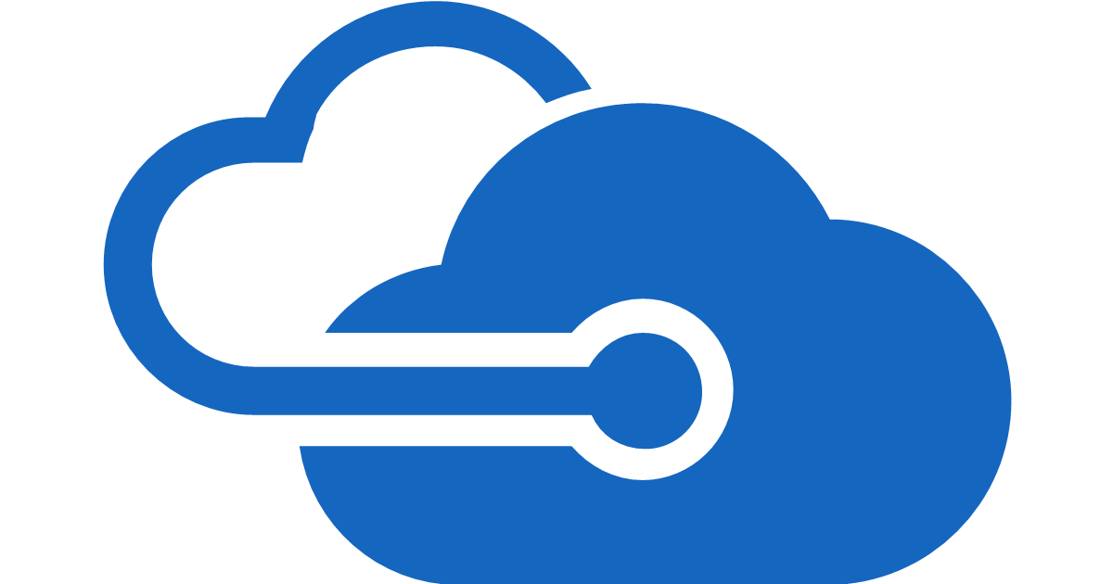
Notes:
Azure AD!

Slide 32
Azure Key Vault
Secret Storage & Management
Certificate Storage & Management
Encryption Key Storage & Encryption Services
Azure AD Access Control

Slide 33
Key Storage Azure Key Vault
Stores Secrets as strings (encrypted at rest)
Option of Hardware Key Modules ($1/month/active key)
Set effective date allowing for preconfigured secret roll overs

Slide 34
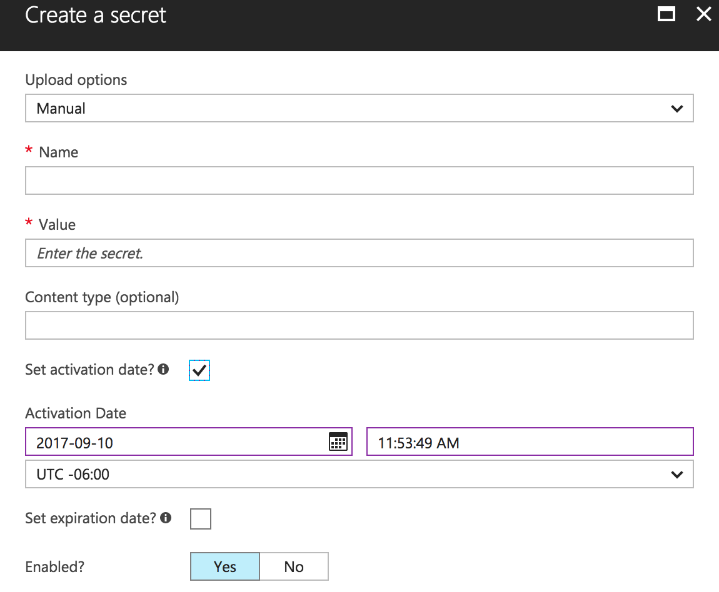
Key Storage Azure Key Vault

Slide 35
Azure AD Certificate Authentication
Associate a certificate public-key as authentication credential for an app
App can gain AccessTokens to authorized Azure Services from AAD by presenting the private key of the registered certificate
Workflow will be familiar to people who have used SSH keys

Slide 36
Gotchas Azure AD Certificate Authentication
Must use PowerShell to configure (portal does not support)
Install Microsoft Azure Powershell package with Platform Installer
Login-AzureRmAccount
New-AzureRmADAppCredential
New-SelfSignedCertificate creates a certificate that is often not usable in .NET apps
.NET framework doesn’t support new CNG key store
Use OpenSSL or other certificate provider

Slide 37
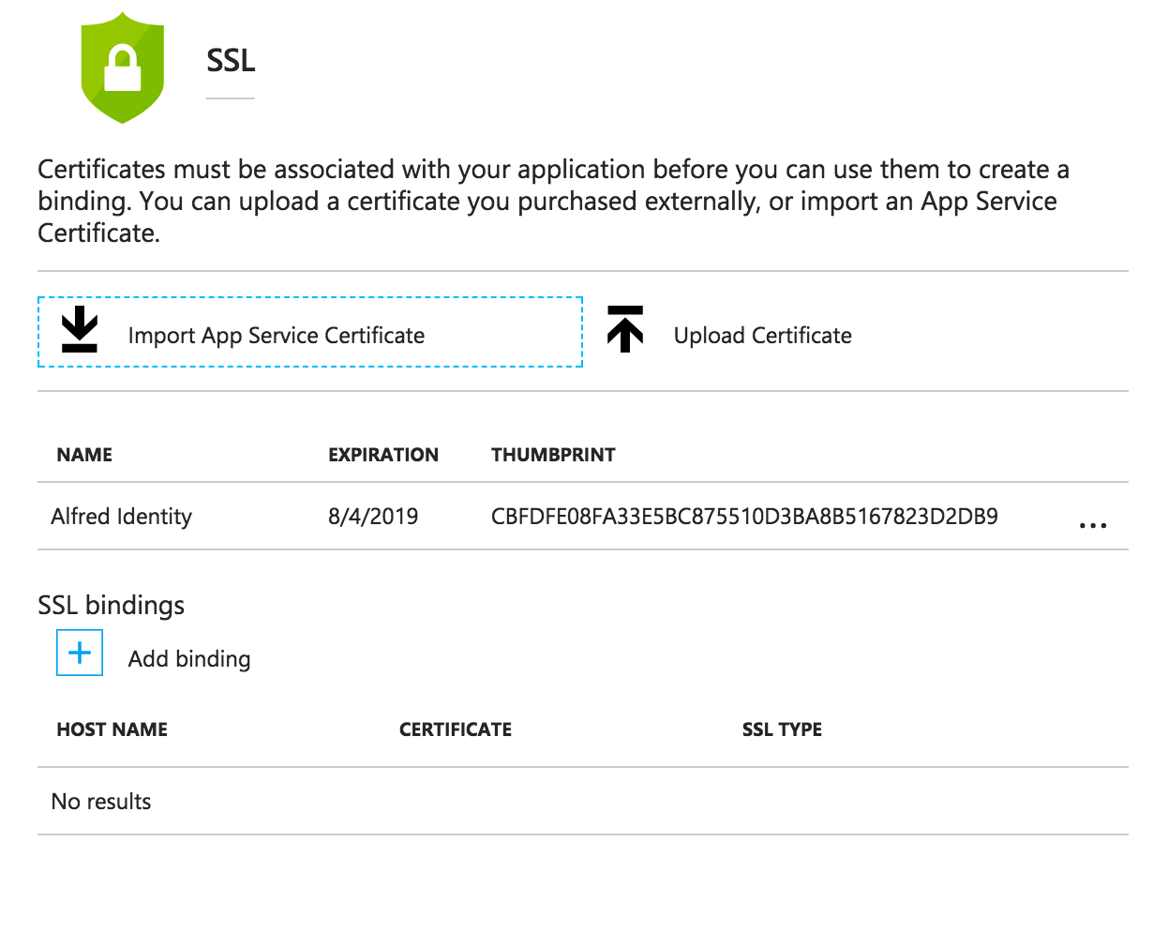
Azure App Service Certificate Access
Notes:
Add private certificate to App Service as SSL certificate

Slide 38
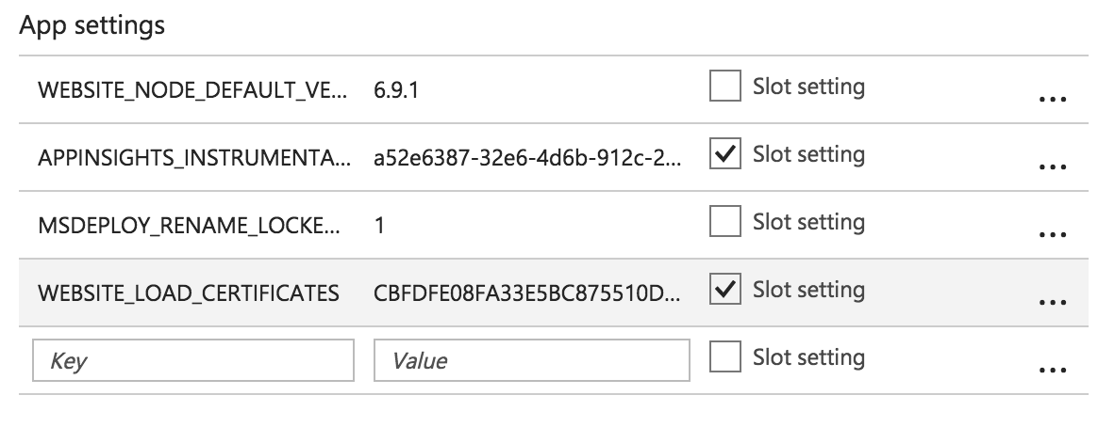
Azure App Service Certificate Access
Notes:
Easy step to miss and the world will be terrible when you do.
Give App Service permission to load certificate
This is not the case by default

Slide 39
Key Flow (talk to Slack API)
IT registers application & adds public key as credential
Azure AD
Application
Key Vault
Slack

Slide 40
Key Flow (talk to Slack API)
IT grants Vault permissions to app identity
Azure AD
Application
Key Vault
Slack

Slide 41
Key Flow (talk to Slack API)
IT installs Private key to OS Cert Store and gives application
read access
Azure AD
Application
Key Vault
Slack

Slide 42
Key Flow (talk to Slack API)
Azure AD
App presents Private key and
requests access token for
Key Vault
Application
Key Vault
Slack

Slide 43
Key Flow (talk to Slack API)
Azure AD
App presents access token and
requests ‘SlackApiToken’
secret from the Vault
Application
Key Vault
Slack

Slide 44
Key Flow (talk to Slack API)
Azure AD
App presents ‘SlackApiToken’
to Slack API and does amazing
bot things that save everyone
time and money!
Application
Key Vault
Slack

Slide 45
Key Flow (talk to Slack API)
Azure AD
IT can control access at any portion of the secret sharing process without having to deal with the app itself.
Application
Key Vault
Slack

Slide 46
Secure Any Azure Service
Azure AD
Application
Key Vault

Slide 47
Secure Any Azure Service
Azure AD
Application
Graph

Slide 48
Secure Any Azure Service
Azure AD
Application
Other App Services

Slide 49
ASP.NET Core Configuration Builder
User Secrets Library
KeyVault Provider

Slide 50
DEMO TIME!

Slide 51
Advantages Azure KeyVault & Certificate Authentication
Gives IT total control of secrets
No development secrets to accidentally check in
Can use configuration to access other Azure Services
Let MS do 90% of the security work for you
Impress your security auditors!

Slide 52
Disadvantages Azure KeyVault & Certificate Authentication
Rework of config system in older apps
Fiddly initial configuration

Slide 53
Take Aways
Security is hard
Build system in security layers
Leave options for IT/Operations to retain control & revoke access
Build your systems to leave yourself as little responsibility/liability as possible. The less you know the less you can screw up.
Notes:
Build your systems to leave yourself as little responsbility/liability as possible. The less you know the less you can screw up.

Slide 55
FIN

Slide 56
But wait! There’s more!

Slide 57
Bonus section: SecureString
Use strong types to say “Hey, this is important and a security concern”
Remove the risk of accidentally writing secrets to logs
Many MS libraries accept SecureString for credentials
(Slightly) reduce attack surface if attacker can get application memory dump

Slide 58
Bonus section: Keybase.io
Use this to securely receive secrets if necessary
Never let a client email a clear text password again
Free!
Easy method for users to GPG encrypt messages that only you can read

Slide 59
Bonus section: Password Managers
Stop remembering passwords
Stop putting passwords in One Note
Use a manager system that uses syncable encrypted files for team access
Keepass is popular for this

Slide 60
FIN
(for reals this time)

